Slide 1

Data Analysis of Per Capita Global GDP Trends (2017)
GROUP 6 / Project 1
Kenneth ACEY, Paul Eppers,
Nadia lashaw, John Klinges
The Data Analytics Boot Camp at
UNC-Chapel Hill

Slide 2
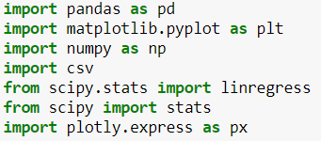
Sources of Information/Communication
JIRA
Data Sources
Dependencies
We used JIRA to track:
Each “story”
Who was responsible for telling it, matching project criteria.
Dependencies in the analysis.
We explored using API’s to obtain the GDP data but instead used:
World Bank open data source(1)
obtaining the datasets via Kaggle.com(2)
Notes:
(1). https://databank.worldbank.org/reports.aspx
(2). https://www.kaggle.com/theworldbank
Notes:
Touch on what motivated us to pick this topic. Describe the questions you and your group found interesting.

Slide 3
Why was this topic chosen?
Why did we pick this topic?
Our Proposal
Our Hypothesis
Our Hypothesis
Thought it would be interesting to determine what components of population most affect absolute and comparative levels of national GDP.
Analyze which countries in the world lead in per capita GDP and what were the drivers of this growth.
GOAL → Create a visualization of the trend for GDP vs. Population growth.
(On a per capita basis), there is a link between countries with strong growth in GDP and various components of population growth (births, immigration).
Notes:
Touch on what motivated us to pick this topic. Describe the questions you and your group found interesting.

Slide 4
Challenges to the Project:
Need to find a good data site
Need to find a pertinent variable to run against GDP
Analyzing linkage between GDP and population levels.
Years of Music:
World Bank website was well suited for:
Sorting by country
and GDP and . Providing required
# of data points and
Saving data pulls
into a csv file.
Divided the national GDP
figure by population to get
GDP per capita.
Considered measuring GDP
against growth in: birth rates,
population, immigration,
and educational levels.
Did we have sufficient data to conclude that growth in population levels are a primary driver of national GDP growth(or other factors?)
Need to measure and analyze outliers to data.
Given more time (and data) we could:
1) Add more years to GDP analysis to reflect global economic trends (war, material changes in energy prices).
2) Adjust GDP / per capita by purchasing power parity,(adjusting the GDP figure by the nation’s cost of living).
3) Add: a) both % of employed people to total population, and b) GDP per employed worker (labor productivity).
Notes:
What would we do if we had 2 more weeks:
Global trends
Go further back by year.

Slide 5
Data Exploration, Clean-up and Visualization Process
Data pulls were saved to a csv file.
2. Saved data then cleaned and
loaded into PY file.
The data was uploaded and stored in a Jupyter notebook.
4. Created dataframes:
Created columns for the Highest and Lowest countries for per capita GDP and population.
5. Created a visualization of GDP highest and lowest countries on a per capita basis.
Regressions and frequency distributions were created. This helped visualize if and how higher population levels were associated with higher levels of GDP.
Revised data frame to show visualized
data.
Used a scatter plot with regression to show the main trends within overall country GDP growth.
Notes:
Run through a jupyter notebook
Discuss insights you had while exploring the data that you didn't anticipate
Multiple subgenres were used to describe each song.
Discuss any problems that arose after exploring the data, and how you resolved them
The spotpy api was a bit cumbersome
Present and discuss interesting figures developed during exploration, ideally with the help of Jupyter Notebook

Slide 6
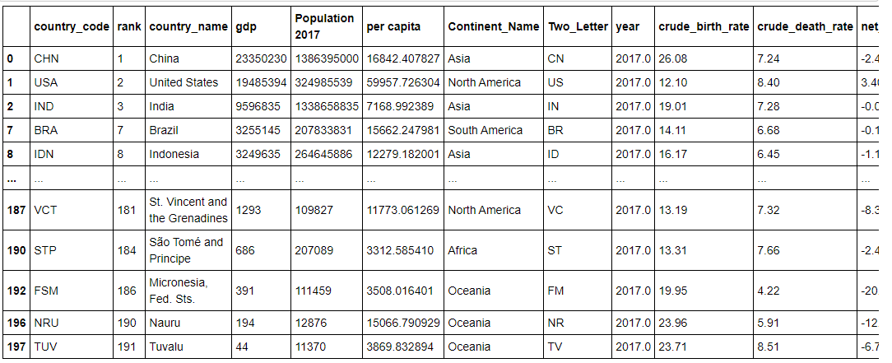
Highest GDP vs. Population (with Birth Rates)

Slide 7
Questions:
What were the leading countries by GDP per capita for the year reviewed (2017)?
What countries have highest levels of population?
Do current levels of GDP in a given country reflect higher levels of population?
What components of population growth (birth rates, immigration) most drive GDP growth?
What other conclusions can be drawn from the data (both numerically and as visualized).
Notes:
Describe whether you were able to answer these questions to your satisfaction.

Slide 8

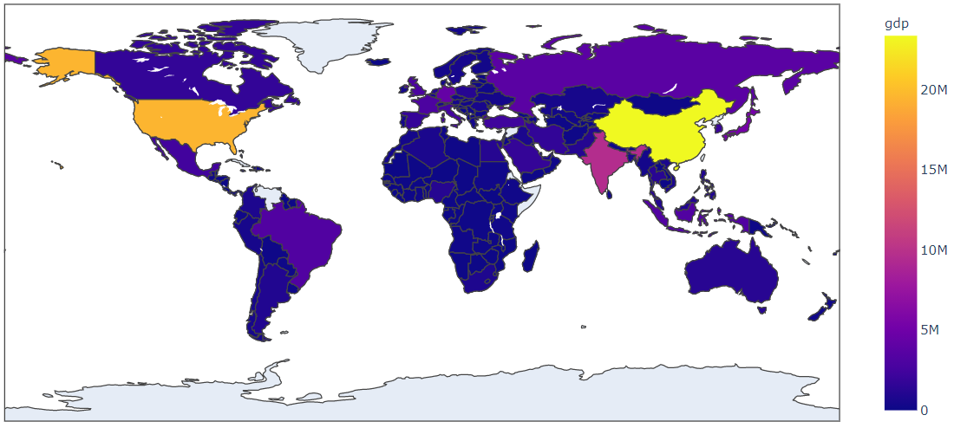
Heat Map – Total GDP by Country

Slide 9
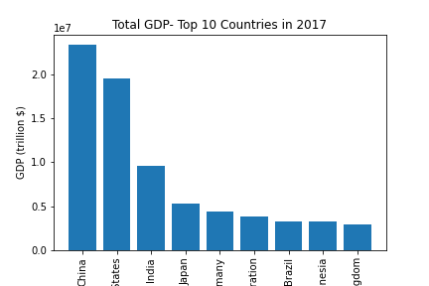
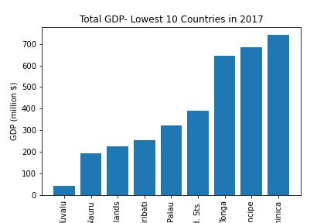
Highest & Lowest Countries by GDP (2017)

Slide 10
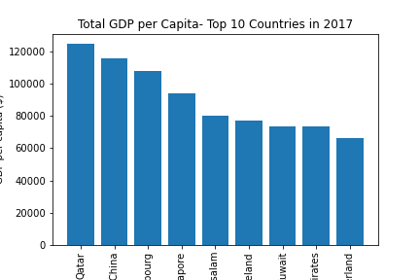
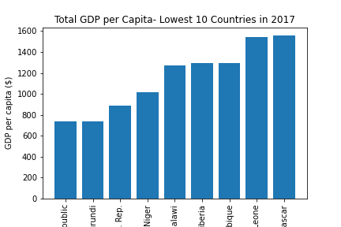
Highest & Lowest Countries by Per Capita GDP

Slide 11
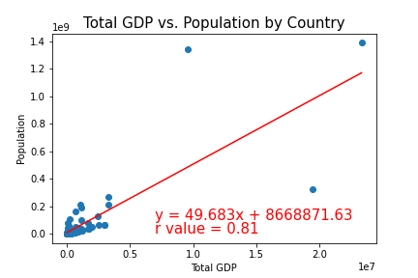
Total GDP vs Population (2017)
Analysis: Regression shows a strong correlation between a country’s overall population rate and GDP level.

Slide 12
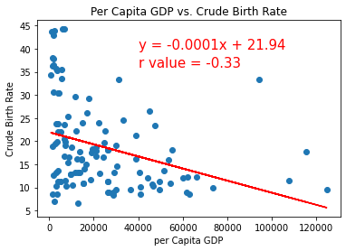
Per Capita GDP vs. Birth Rate (2017)
Analysis: Regression suggests that high GDP countries have low birth rates (per 1000 people). If we have more time, we would collect data and incorporate the affect of cultural factors (that may differ by country/regions) on low birth rates.

Slide 13
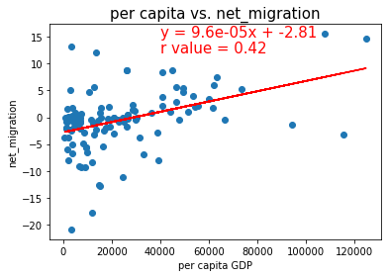
Per capita GDP vs. Net Migration (2017)
Analysis: Regression does show moderate relationship between a country’s per capita GDP and net mitigation (immigration in and out) as part of a country’s population.

Slide 14
CONCLUSIONS/IMPLICATIONS
We learned:
An expansion of the workforce population almost invariably increases a
country’s total output level, as measured by GDP.
Immigration’s effect on population growth is one of the key factors behind
GDP growth (on an absolute and per capita basis).
Future analysis could provide evidence if:
Affect of cultural factors (for countries/regions) on birth rates.
Foreign-born workers also affect the level and growth rate of per-capita
income for the entire country’s population.
This trend continues if per capita income (as a measure of standard of living)
is adjusted for a country’s Purchasing Power Parity (PPP, i.e. cost of living).
Growth in GDP from immigration reflects a higher % of immigrants of working
age (those aged 15 and above) compared to the native-born population.

